Slide 1
Information Gathering: Unobtrusive Methods
5
Kendall & Kendall Systems Analysis and Design, 9e
Notes:
1

Slide 2
Learning Objectives
Recognize the value of unobtrusive methods for information gathering.
Understand the concept of sampling for human information requirements analysis.
Construct useful samples of people, documents, and events for determining human information requirements.
Create an analyst’s playscript to observe decision-maker activities.
Apply the STROBE technique to observe and interpret the decision-maker’s environment.

Slide 3
Unobtrusive Methods
Less disruptive
Insufficient when used alone
Multiple methods approach
Used in conjunction with interactive methods
Notes:
Unobtrusive methods:
sampling
investigation
observing
Multiple methods approach—using unobtrusive methods in conjunction with interactive methods.
Using both interactive and unobtrusive methods will result in a more complete picture of human information requirements.

Slide 4
Major Topics
Sampling
Quantitative document analysis
Qualitative document analysis
Observation
STROBE
Applying STROBE

Slide 5
Sampling
A process of systematically selecting representative elements of a population
Involves two key decisions:
What to examine
Which people to consider
Notes:
By selecting a representative population the analyst can reveal useful information about the population as a whole.
What to examine—there are many reports, forms, output documents, memos, and websites that have been generated by people in the organization.
Which people to consider—which people should be selected to represent the population as a whole?

Slide 6
Need for Sampling
The reasons systems analysts do sampling are:
Containing costs
Speeding up the data gathering
Improving effectiveness
Reducing bias
Notes:
Containing costs:
examining every document, talking to everyone, and reading every Web page would be to costly.
employee time, copying reports, and duplicating unnecessary reports would be an added expense
Speeding up the data gathering—sampling speeds up the process by examining a smaller population which in turn reduces the amount of data that needs to be analyzed.
Improving effectiveness—by examining a sample of the population more detailed questions can be answered and followed up on thus improving the effectiveness of data gathering
Reducing bias.

Slide 7
Need for Sampling
Too costly to:
Examine every scrap of paper
Talk with everyone
Read every web page from the organization

Slide 8
Sampling
Sampling helps accelerate the process by gathering selected data rather than all data for the entire population
The systems analyst is spared the burden of analyzing data from the entire population

Slide 9
Sampling Effectiveness
Sampling can help improve effectiveness if information that is more accurate can be obtained
This is accomplished by talking to fewer employees but asking them questions that are more detailed
If less people are interviewed, the systems analyst has more time to follow up on missing or incomplete data

Slide 10
Sampling Bias
Data gathering bias can be reduced by sampling
When the systems analyst asks for an opinion about a permanent feature of the installed information system, the executive interviewed may provide a biased evaluation because there is little possibility of changing it

Slide 11
Sampling Design
To design a good sample, a systems analyst must follow four steps:
Determining the data to be collected or described
Determining the population to be sampled
Choosing the type of sample
Deciding on the sample size
Notes:
Determining the data to be collected or described—if irrelevant data are gathered, then time and money are wasted in the collection, storage, and analysis of useless data.
Determining the population to be sampled—must determine what the population is.
Choosing the type of sample—there are four type of samples: convenience, purposive, simple, and complex.
convenience samples—unrestricted, nonprobability samples, easiest to arrange but also the most unreliable
purposive samples—based on judgment, moderately reliable
simple—need a numbered list of the population to ensure an equal chance of being selected, often not practical
complex random samples:
systematic—example might be to select every kth person
stratified—process of identifying subpopulations, or strata, and then selecting from these subpopulations
cluster—select a group representative of all the groups of that type
Deciding on the sample size—needs to be greater then 1 but less than the size of the population itself. The absolute number is more important then the percentage of the population.

Slide 12
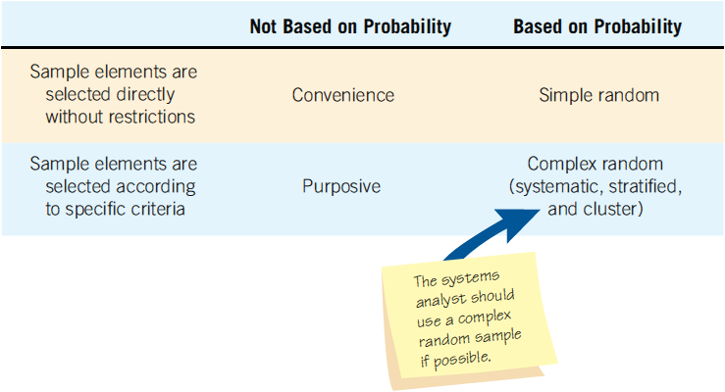
Four Main Types of Samples the Analyst Has Available (Figure 5.1)

Slide 13
Four Main Types of Samples
Convenience
Purposive
Simple random
Complex random

Slide 14
Convenience Samples
Convenience samples are unrestricted, nonprobability samples.
This sample is the easiest to arrange
The most unreliable

Slide 15
Purposive Sample
A purposive sample is based on judgment
Choose a group of individuals who appear knowledgeable and are interested in the new information system
A nonprobability sample
Only moderately reliable

Slide 16
Complex Random Samples
The complex random samples that are most appropriate for a systems analyst are
Systematic sampling
Stratified sampling
Cluster sampling

Slide 17
The Sample Size Decision
Determine the attribute
Locate the database or reports in which the attribute can be found
Examine the attribute
Make the subjective decision regarding the acceptable interval estimate
Choose the confidence level
Calculate the standard error
Determine the sample size
Notes:
The sample size often depends on the cost involved or the time required by the systems analysts, or even the time available by people in the organization.
Determine the attribute—determine the attribute to sample.
Locate the database or reports in which the attribute can be found—find out where the data is stored; database, on a form, or in a report.
Examine the attribute—estimate ρ, the proportion of the population having the attribute. A value of .10 generally results in an acceptable sample size.
Make the subjective decision regarding the acceptable interval estimate—this is purely a subjective decision. An interval estimate (i) of ± .10 means an error of no more than 0.10 in either direction from the actual proportion, ρ.
Choose the confidence level—the desired degree of certainty and then look up the confidence coefficient level (z value) in a table.

Slide 18
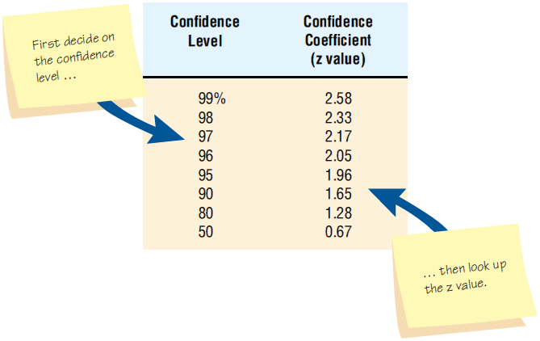
A Table of Area under a Normal Curve Can Be Used to Look up a Value Once the Systems Analyst Decides on the Confidence Level (Figure 5.2)
Notes:
The choice of the confidence level is purely subjective. It is the desired degree of certainty.

Slide 19
Calculate the Standard Error of the Proportion
σ_{p} = i/z
i = interval estimate
z = confidence coefficient found in the confidence level lookup table

Slide 20
Determine the Sample Size
σ_{p} = standard error
ρ = the proportion of the population having the attribute
p(1-p)
n = + 1
σ_{p}²

Slide 21
Example: A. Sembly Company
Determine that you are looking for orders with mistakes
Locate order forms from the past six months
Examine order forms and conclude that p = 5%
Subjective decision of acceptable interval i = ± 0.02
Look up confidence coefficient z - value = 1.96
Calculate σ_{p} = i / z = 0.02/1.96 = 0.0102
Determine n; n = 458
Notes:
The higher the confidence level the larger the sample size. If we increase the confidence level from 95 to 99% the sample size would increase from 458 to 1,827.

Slide 22
Investigation
The act of discovery and analysis of data
Hard data
Quantitative
Qualitative
Notes:
Hard data reveal where the organization has been and where its members believe it is going.

Slide 23
Analyzing Quantitative Documents
Reports used for decision making
Performance reports
Records
Data capture forms
Ecommerce and other transactions
Notes:
All these documents have a specific purpose and audience for which they are targeted.

Slide 24
Reports Used for Decision Making
Sales reports
Production reports
Summary reports
Notes:
Sales reports—summarize the amount sold and the type of sales. They might include graphical output comparing revenue and income over a set number of periods.
Production reports—include recent costs, current inventory, recent labor, and plant information.
Summary reports—provide background information, spot exceptions to normal occurrences, and afford strategic overviews of organizational plans.

Slide 25
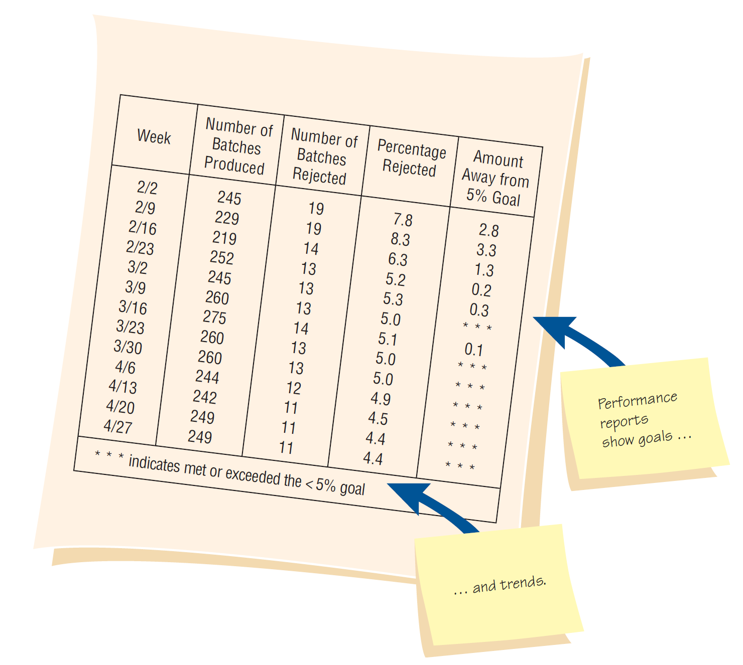
A Performance Report Showing Improvement (Figure 5.3)

Slide 26
A Manually Completed Payment Record (Figure 5.4)
Notes:
Ways to inspect a record:
checking for errors in amounts and totals
looking for opportunities for improving the recording form design
observing the number and type of transaction
watching for instances in which the computer can simplify the work

Slide 27
Records
Records provide periodic updates of what is occurring in the business
There are several ways to inspect a record:
Checking for errors in amounts and totals
Looking for opportunities for improving the recording form design
Observing the number and type of transactions
Watching for instances in which the computer can simplify the work (calculations and other data manipulation)

Slide 28
Data Capture Forms
Collect examples of all the forms in use
Note the type of form
Document the intended distribution pattern
Compare the intended distribution pattern with who actually receives the form
Notes:
Blank forms can be compared with filled-in forms to:
see if any data items are consistently left blank
see if the people who are supposed to receive the forms actually do
see if standard procedures for using, storing, and discarding them are followed

Slide 29
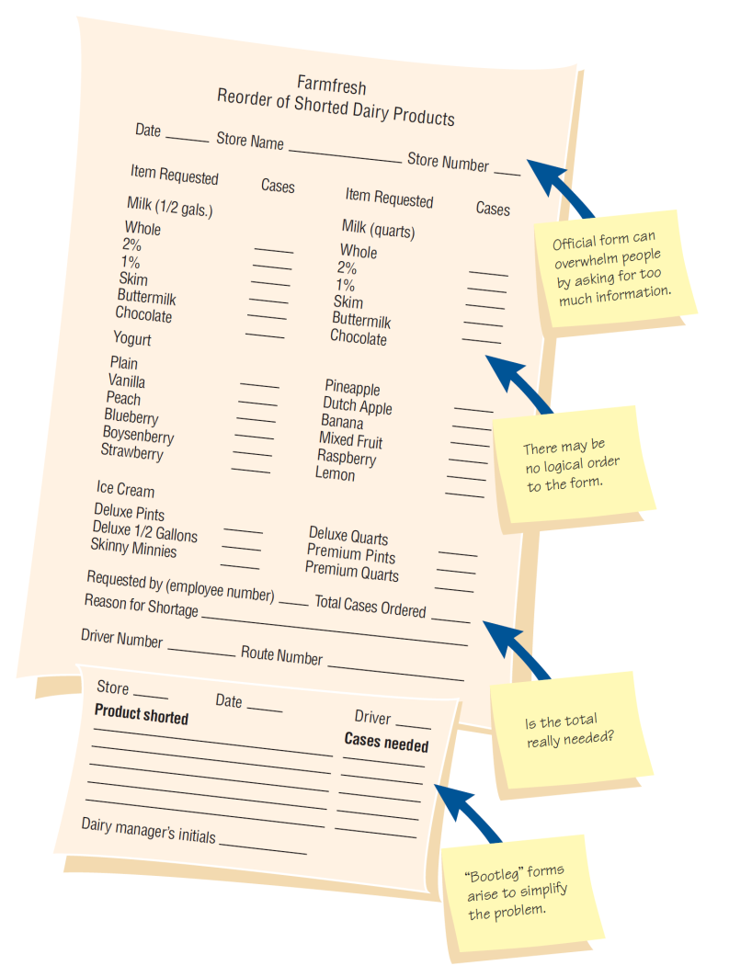
Questions to Ask about Official and Bootleg Forms that Are Already Filled out (Figure 5.5)
Notes:
Is the form filled out in its entirety?
Are there forms that are never used? Why?
Are all copies of forms circulated to the proper people or filled appropriately? If not, why not?
If there is a paper form that is offered as an alternative to a Web-based form, compare the completion rates for both.
Are “unofficial” forms used o a regular basis?

Slide 30
Questions to Ask About Forms
Is the form filled out in its entirety?
Are there forms that are never used?
Are all copies of forms circulated to the proper people or filed appropriately?
Can people who must access online forms do so?
If there is a paper form that is offered as an alternative to a Web-based form, compare the completion rates for both
Are “unofficial” forms being used on a regular basis?

Slide 31
Analyzing Qualitative Documents
Key or guiding metaphors
Insiders vs. outsiders mentality
What is considered good vs. evil
Graphics, logos, and icons in common areas or web pages
A sense of humor
Notes:
Includes email messages, memos, signs on bulletin boards and in the work areas, web pages, procedure manuals, and policy handbooks.

Slide 32
Analyzing Qualitative Documents
Email messages and memos
Signs or posters on bulletin boards
Corporate websites
Manuals
Policy handbooks
Notes:
Corporate websites—examine the contents for metaphors, humor, use of design features and the meaning and clarity of any messages provided.
Manuals—present the “idea,” the way machines and people are expected to behave.
Policy handbooks—allows the systems analyst to gain an awareness o the values, attitudes, and beliefs guiding the company.

Slide 33
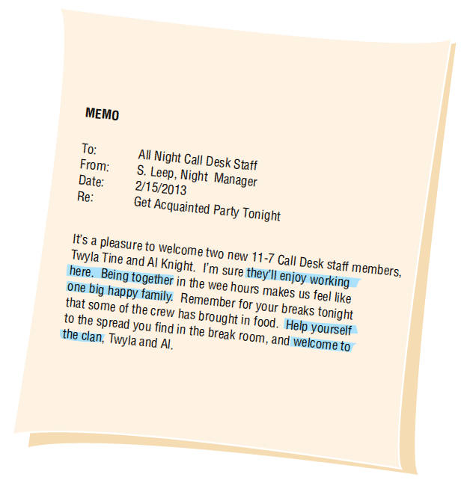
Analysis of Memos Provides Insight into the Metaphors that Guide the Organization’s Thinking (Figure 5.6)
Notes:
Memos reveal a lively, continuing dialogue in the organization.

Slide 34
Observation
Observation provides insight on what organizational members actually do
See firsthand the relationships that exist between decision makers and other organizational members
Can also reveal important clues regarding HCI concerns
Notes:
Observing the decision maker; and the decision maker’s physical environment; and their interaction with their physical, ergonomic environment are important unobtrusive methods.

Slide 35
Analyst’s Playscript
Involves observing the decision-makers behavior and recording their actions using a series of action verbs
Examples:
Talking
Sampling
Corresponding
Deciding
Notes:
Observation allows the analyst to see firsthand how managers gather, process, share, and use information and technology to get work done.

Slide 36
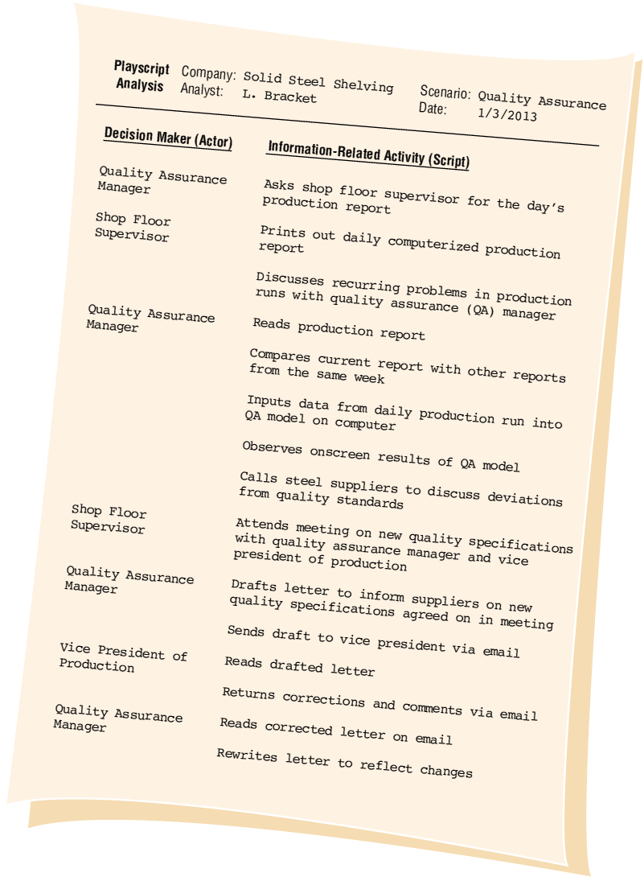
A Sample Page from the Analyst’s Playscript (Figure 5.7)

Slide 37
STROBE
STRuctured OBservation of the Environment—a technique for observing the decision-maker’s physical environment
Notes:
Observing the physical environment also reveals much about decision makers human information requirements.

Slide 38
STROBE
Often it is possible to observe the particulars of the surroundings that will confirm or negate the organizational narrative
Also called stories or dialogue
Information that is found through interviews or questionnaires

Slide 39
STROBE Elements
Office location
Desk placement
Stationary equipment
Props
External information sources
Office lighting and color
Clothing worn by decision makers
Notes:
These elements can reveal much about the way a decision maker gathers, processes, stores, and shares information, as well as about the decision maker’s credibility in the workplace.

Slide 40
Office Location
Who has the corner office?
Are the key decision makers dispersed over separate floors?

Slide 41
Desk Placement
Does the placement of the desk encourage communication?
Does the placement demonstrate power?

Slide 42
Stationary Office Equipment
Does the decision maker prefer to gather and store information personally?
Is the storage area large or small?

Slide 43
Props
Is there evidence that the decision maker uses a PC, smart phone, or tablet computer in the office?

Slide 44
External Information Sources
Does the decision maker get much information from external sources such as trade journals or the Web?

Slide 45
Office Lighting and Color
Is the lighting set up to do detailed work or more appropriate for casual communication?
Are the colors warm and inviting?

Slide 46
Clothing
Does the decision maker show authority by wearing conservative suits?
Are employees required to wear uniforms?

Slide 47
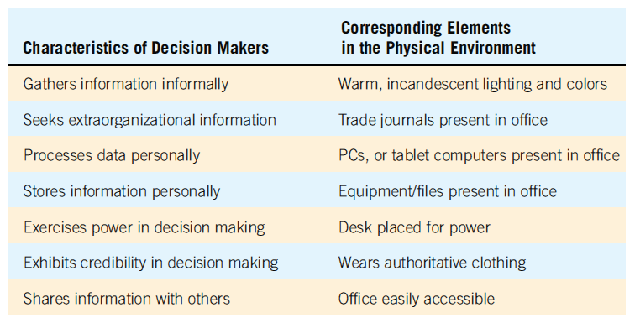
STROBE and Decision-Maker Characteristics (Figure 5.9)

Slide 48
Applying STROBE
The five symbols used to evaluate how observation of the elements of STROBE compared with interview results are:
A checkmark means the narrative is confirmed
An “X” means the narrative is reversed
An oval or eye-shaped symbol serves as a cue to look further
A square means observation modifies the narrative
A circle means narrative is supplemented by observation
Notes:
One way to implement STROBE is through the use of an anecdotal checklist with meaningful shorthand symbols.

Slide 49
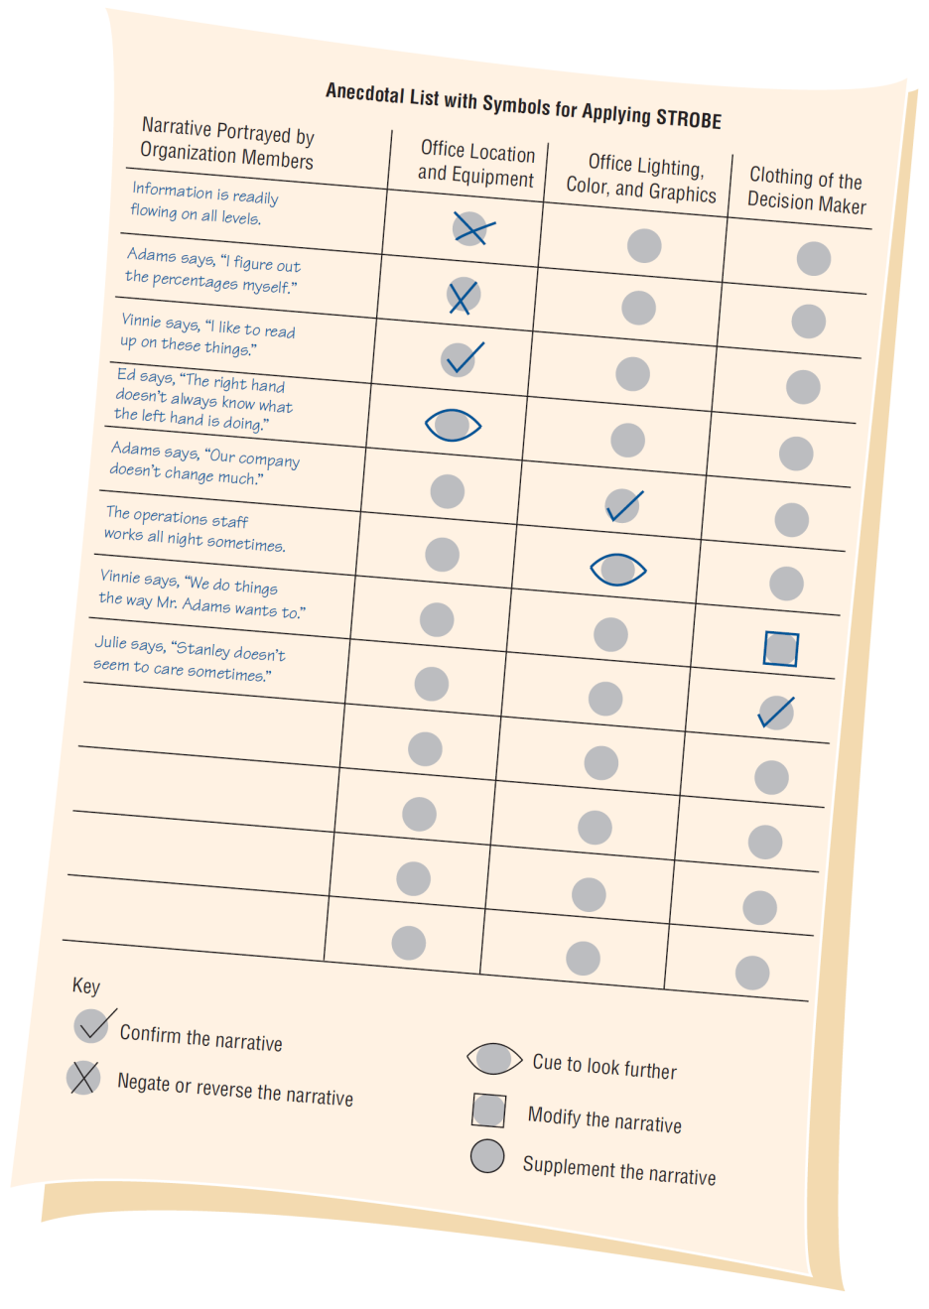
An Anecdotal List with Symbols (Figure 5.10)

Slide 50
Summary
Sampling
Designing a good sample
Types of samples
Sample size
Hard data
Quantitative document analysis
Qualitative document analysis
Observation
Playscript
STROBE
STROBE elements
Applying STROBE

Slide 51

Copyright © 2014 Pearson Education, Inc.
Publishing as Prentice Hall

